Slide 1

Retriever Student Services
Welcome to UMBC Off-Campus Housing Support
SAFE-MD: Statistical Analysis and Forecasting of Crime Events in Maryland
Supporting Your Transition to Living Off Campus
Notes:
Welcome everyone! Whether you're coming from another country or state, settling into off-campus housing can be overwhelming. I’m here to walk you through everything—from finding a place to understanding your rights—so you feel confident and supported.

Slide 2
What We Offer at DOS?
Your Housing Support Team
✅ Housing Listings & Roommate Finder
✅ Lease Guidance & Tenant Rights
✅ Transit & Local Resource Info
✅ Legal Aid Resources
*Source: https://studentaffairs.umbc.edu/student-support/retriever-support-services/off-campus-housing-resources/
Notes:
RSS provides free tools and guidance to help you find housing, understand leases, connect with roommates, and navigate transportation and local services. We’re your first stop for off-campus support.

Slide 3
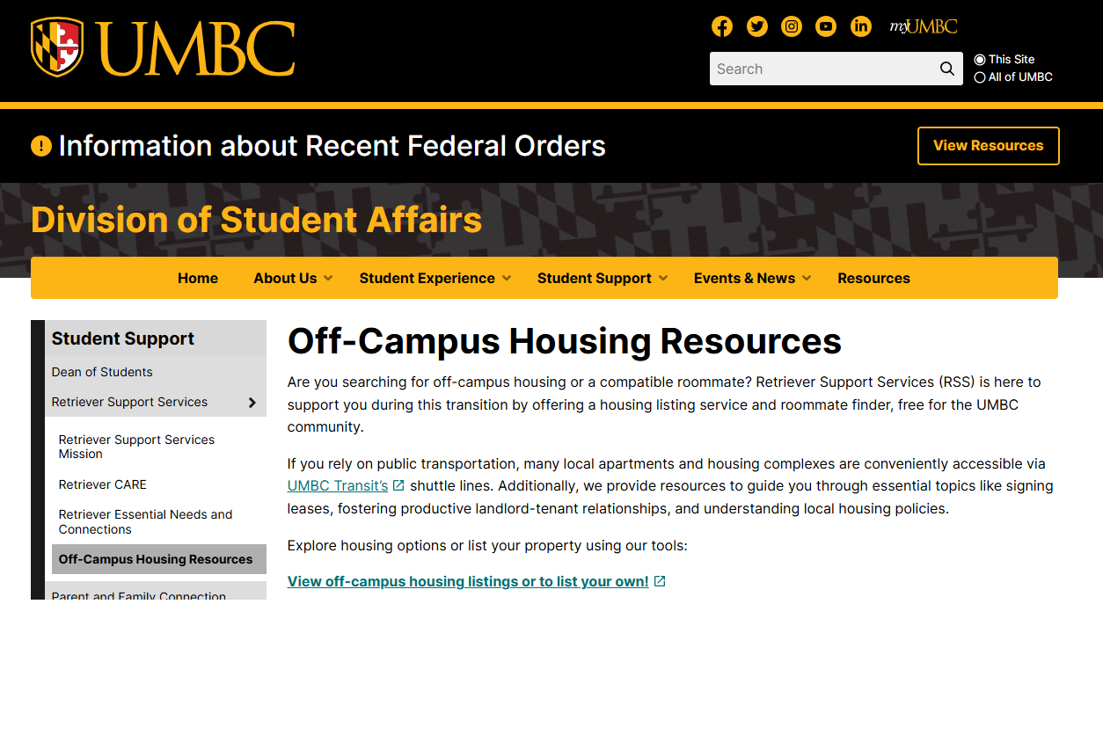
Off-Campus Website
*Source: https://studentaffairs.umbc.edu/student-support/retriever-support-services/off-campus-housing-resources/
Notes:
RSS provides free tools and guidance to help you find housing, understand leases, connect with roommates, and navigate transportation and local services. We’re your first stop for off-campus support.

Slide 4
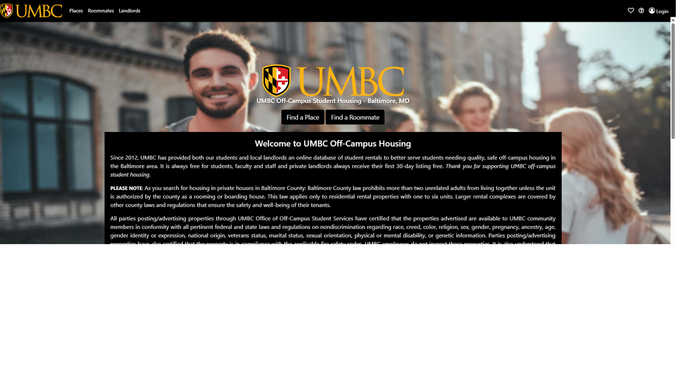
Where to Start?
Finding Your Home
🌐 Off-Campus Housing 101
🔍 Search listings or post your own
🧍‍♂️Use roommate finder
📌 Post profiles in myUMBC Classifieds
*Source: https://umbc.och101.com/

Slide 5
Identifying Your Needs:
What to Consider Before Renting?
🏠 Apartment type: Studio, 1–3 bedroom, shared housing
🚌 Transit access: UMBC Shuttle, MTA bus/metro
🛒 Nearby stores, pharmacy, job location
🔐 Privacy: Private vs. shared rooms/bathrooms
💰 Budget: Rent + utilities
*Source: https://studentaffairs.umbc.edu/student-support/retriever-support-services/off-campus-housing-resources/

Slide 6
Transportation Access:
Getting Around Without a Car
🚍 UMBC Transit: Free shuttle routes to major housing zones
🗺️ MTA Bus & Metro: Statewide access
🚶 Walkability: Close to campus = higher rent
*Source: https://studentaffairs.umbc.edu/student-support/retriever-support-services/off-campus-housing-resources/

Slide 7
Rental Requirements:
What You’ll Need to Rent?
International Students:
  Passport & I-94
  I-20 with OPT/CPT (if applicable)
  Admission Letter & $22k/year proof
  Co-signer (if no US credit
Domestic Students:
  Photo ID, SSN
  Proof of income (3x rent)
  Credit score >650 or Parent or Legal Guardian
*Source: https://studentaffairs.umbc.edu/student-support/retriever-support-services/off-campus-housing-resources/

Slide 8


Housing Timeline:
When To Start Looking for Housing?
  Looking for new apartment: 45-60 days
  Renewal: 60 days
  NOW!!
*Source: https://studentaffairs.umbc.edu/student-support/retriever-support-services/off-campus-housing-resources/

Slide 9
Understanding Leases:
What is a Lease?
📝 A legal rental agreement
✔ Protects tenant & landlord
🔒 Locks your rent rate
🕵️ Inspect before signing
📌 Note and photograph damages
*Source: https://studentaffairs.umbc.edu/student-support/retriever-support-services/off-campus-housing-resources/

Slide 10
Maryland Lease Laws (Simplified):
Lease & Co-Signer Laws in Maryland
📖 Sec 8-205: Lease must be written
📖 Sec 8-213: Co-signers are liable if you don’t pay
📖 Sec 8-208: Can’t auto-renew without notice
*Source: https://studentaffairs.umbc.edu/student-support/retriever-support-services/off-campus-housing-resources/

Slide 11
Security Deposits:
Security Deposits – What to Know
💵 Max 2 months’ rent
🏦 Must be in an interest-bearing account
📸 Document house’s move-in condition
🧾 Always get a receipt
🧾 Get charges list at move-out
*Source: https://studentaffairs.umbc.edu/student-support/retriever-support-services/off-campus-housing-resources/
Notes:
Your deposit is refundable, but only if you follow the process: document everything, don’t damage the unit, and give proper notice. Know the difference between damage and wear and tear.

Slide 12
Damage vs. Wear and Tear:
Know the Difference
Wear and Tear (Not charged):
✔ Minor scuffs
✔ Loose door knobs
Damage (You pay):
✘ Broken windows
✘ Stained carpet
✘ Unauthorized paint
*Source: https://studentaffairs.umbc.edu/student-support/retriever-support-services/off-campus-housing-resources/

Slide 13
Ending the Lease & Evictions:
Ending a Lease or Facing Eviction
📅 Give 60-day written notice to leave
📬 Use email for records
⚖ Evictions go through court
📑 Landlord must file & prove cause
*Source: https://studentaffairs.umbc.edu/student-support/retriever-support-services/off-campus-housing-resources/

Slide 14
Working with Your Landlord:
Building a Healthy Relationship
📧 Communicate in writing
🛠️ Report issues quickly
📋 Request repairs formally
💬 Be respectful and clear
*Source: https://studentaffairs.umbc.edu/student-support/retriever-support-services/off-campus-housing-resources/

Slide 15
When to Get Help:
Free Legal Help & Advice
👨‍⚖️ JustAdvice: 30-min free consultation
⚖ Maryland Pro-Bono Resource Center
📃 MD Volunteer Lawyers: Lease review
⚖ MD Legal Aid: Eviction defense
🏛️ Baltimore Rent Court: Small claims
If you’re stuck, don’t panic. You have support. Maryland offers free legal services for leases, eviction, and deposits. We also help guide you to the right place.
*Source: https://studentaffairs.umbc.edu/student-support/retriever-support-services/off-campus-housing-resources/

Slide 16
Final Tips:
🗂️ Document everything
📧 Use email for all landlord communication
🔍 Inspect before and after
🕑 Give 60-day notice
📞 RSS is always here to help; Make apt with us to walk through resources before signing a lease.
*Source: https://studentaffairs.umbc.edu/student-support/retriever-support-services/off-campus-housing-resources/

Slide 17
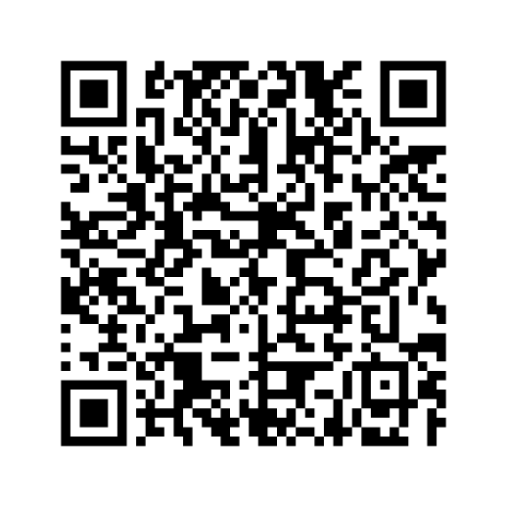
To Reach Out:
Griselda Flores, Ph.D., Director, Essential Needs and Connections
Phone: +1 (410)-455-2770
Email: ocss@umbc.edu
UMBC Off-Campus Housing Website
Notes:
RSS provides free tools and guidance to help you find housing, understand leases, connect with roommates, and navigate transportation and local services. We’re your first stop for off-campus support.

